Slide 1

Understanding
Sexually Transmissible
Infections (STIs)

Slide 2

Today we will talk about…
What you need to know about STIs
How people get STIs and possible symptoms
Who should get tested
Where and how to get tested
How to treat STIs
Preventing STIs
Sharing your STI status
Getting help and support

Slide 3

What are STIs and why
STIs means Sexually Transmissible Infections:
STIs are infections caused by bacteria, viruses or parasites
STIs caused by bacteria are more common in Australia
they matter?
STIs matter because:
STIs can be treated, and some can be cured
If not treated, they can lead to serious health problems
Many people may have an STI without knowing which increases its transmission to other people
It’s important to get tested regularly
to know if you have an STI.

Slide 4

What are the
most common STIs?
STIs caused by bacteria
STIs caused by viruses
STIs caused by parasites
syphilis
chlamydia
gonorrhoea
mpox (monkey pox)
human immunodeficiency
virus (HIV)
genital herpes
genital warts
hepatitis B
trichomoniasis (trich)
pubic lice (scabies)
The most common STIs in Australia are chlamydia, gonorrhea, syphilis.

Slide 5

How do you
get STIs?
During vaginal,
oral or anal sex
Sharing bodily fluids including semen, vaginal fluids, breast milk or blood
Through close
skin-to-skin
contact
During pregnancy, childbirth and through breastfeeding

Slide 6
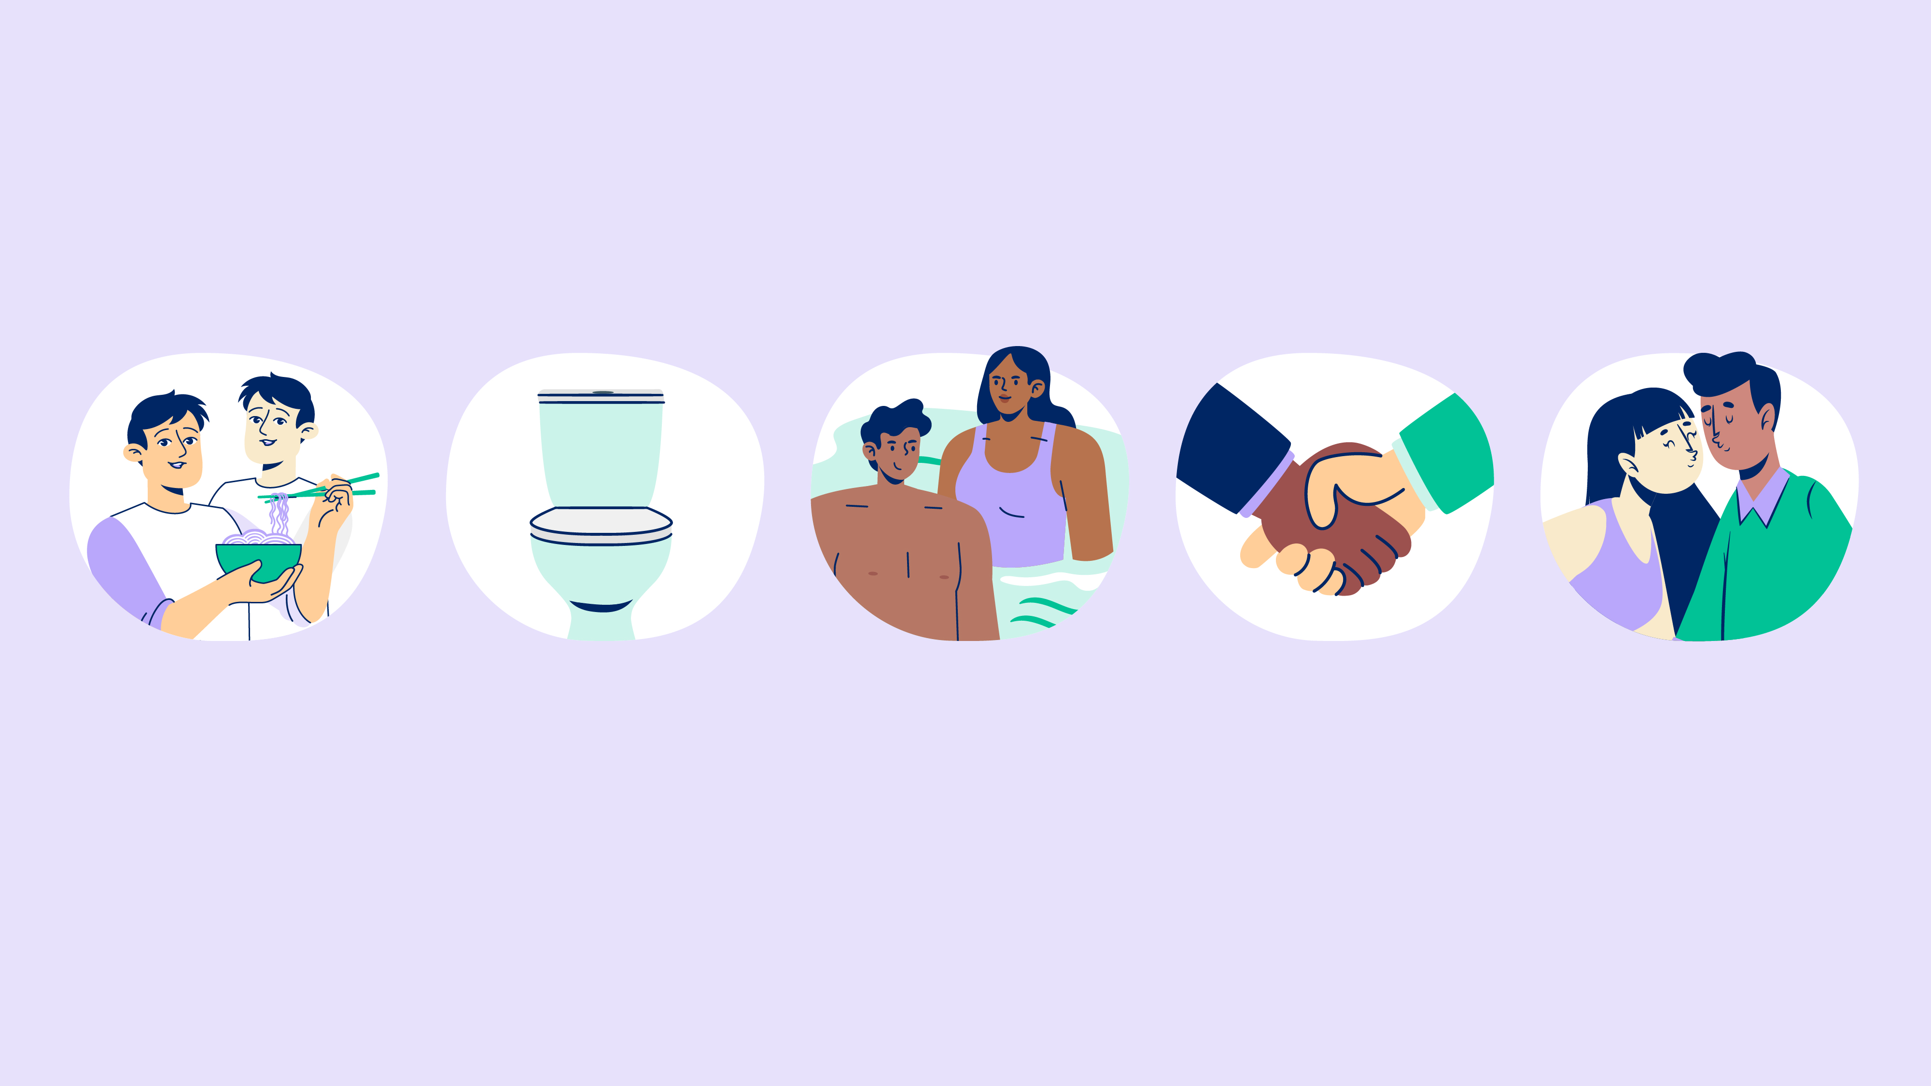
You cannot get
STIs from...
Sharing food
or utensils
Sharing
toilet seats
Sharing showers or swimming pools
Handshaking
Dry kissing

Slide 7

Common
symptoms
of syphilis
Sores in or on the mouth, penis, vagina anus or cervix
Red rash on the hands, back, chest or feet
Swollen glands in your armpits or groin
Fever
Hair loss
Headaches
Tiredness
If not treated, syphilis can lead to serious issues

Slide 8

Common
symptoms of chlamydia and gonorrhea
Penis/urethral and vaginal discharge
Pain in the pelvis
Bleeding from the vagina
Pain while peeing
Pain during or after sex
Pain in the testicles
Anal pain or discharge
Painful when passing stool
Regular testing is the only way
to check if you have an STI.

Slide 9
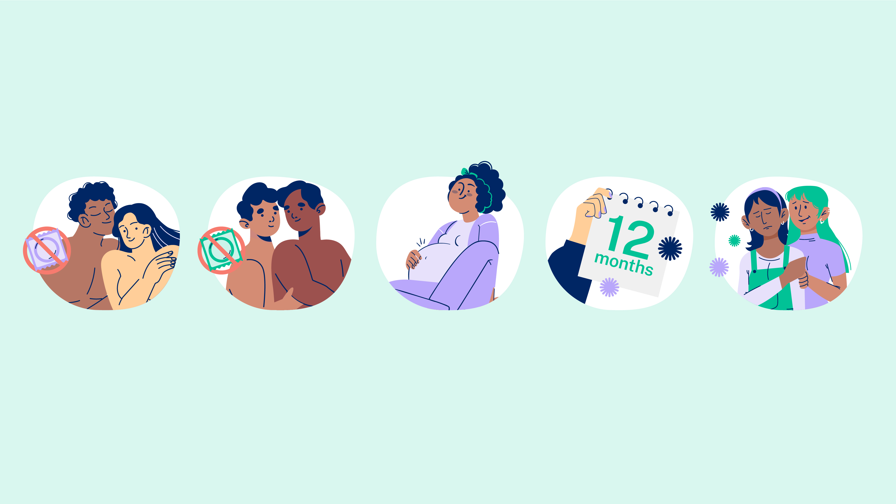
Who should get
an STI test?
Consider getting tested if you:
Getting tested often is good for your health
Had sex without
a condom
(unprotected sex)
Are a sexually active man who has unprotected sex with men
Are pregnant
or planning
to get pregnant
Had an
STI in the last
12 months
Or your sexual
partners have
any symptoms
(but most STIs don’t
show symptoms)

Slide 10

What are the types
of tests for STIs?
syphilis
chlamydia and gonorrhoea
a blood test
a swab of the ulcer or sore
a urine sample
a swab from vagina,
anus or throat
Regular testing is the only way to check if you have an STI.

Slide 11

Where can
I get tested
You can get an STI test at:
Your doctor or a GP
NSW Sexual Health Clinics
Family Planning Centres
for STIs?
STI testing is quick, easy and confidential.

Slide 12

STI testing:
What might you be asked?
Do you have any symptoms you’re concerned about?
When was the last time you had sex?
Have you ever been tested for STIs before?
Do you have sex with people with a penis, a vagina or both?
You can get STIs in your throat, bottom or genitals. Do you think we should test any of these sites?
When was the last time you had sex without a condom?
Do you use other contraception?
Have you ever had unwanted sex?

Slide 13

What is the treatment
Syphilis, chlamydia
and gonorrhoea are all treated with antibiotics
for STIs?
Reinfection
is possible.
Test often.

Slide 14

How can I protect
myself from STIs?
Having safe sex is the
best way to protect yourself.
Use condoms or dams when
having any type of sex, including:
Vaginal sex
Anal sex
Oral sex

Slide 15

Do I need to
tell anyone
I have an STI?
Not legally required to tell someone
Important to tell your sexual partners
Responsible for taking reasonable precautions
Criminal offence if transmission is intentional
Having an STI is very common.
There is no need to be ashamed.

Slide 16

What have we
learnt today?
True or False?
Only people with multiple sexual partners get STIs.
You can tell if someone has an STI by looking at them.
You can get STIs by sitting on a toilet seat.
Condoms can completely protect against all STIs.
You can only get STIs from vaginal sex.

Slide 17

Where can
I get help?
To find a doctor or GP
www.healthdirect.gov.au/australian-health-services
No medicare card required
Sexual Health InfoLink
www.shil.nsw.gov.au or 1800 451 624
Legal services (HALC)
www.halc.org.au or (02) 9492 6540
A free
notification
service
Let Them Know
www.letthemknow.org.au

Slide 18

Where can
I find more
information
about STIs?
Multicultural HIV and Hepatitis Service
www.mhahs.org.au
Sexual Health Plus
www.health.nsw.gov.au/sexualhealth
Health Direct
www.healthdirect.gov.au/sexually-transmitted-infections-sti
International Student Health Hub
www.internationalstudents.health.nsw.gov.au/sti
(with translated factsheets in Nepali, Hindi, Thai and Mandarin)
Play safe
www.playsafe.health.nsw.gov.au
(sexual health information to young people across NSW)
Family Planning Australia
www.fpnsw.org.au

Slide 19
Where to get help
in your language
If you need assistance with
talking to your doctor or health
provider in your language:
Call the Translating and Interpreting Service (TIS) on 13 14 50
The service is free and confidential
Ask the receptionist to book a free interpreter for you

Slide 20

Messages to
take away
Most STIs don’t show any symptoms, the best way
to know if you have an STI is to get tested.
If STIs are not treated, they may lead to
serious health problems.
STI testing is quick, easy, confidential
and often free at sexual health clinics​.
Get tested regularly​.
All STIs are treatable and some STIs are curable.

Slide 21

Questions?

Slide 22
Developed by:
NSW Multicultural HIV
and Hepatitis Service
(MHAHS) mhahs.org.au
August 2025

