Slide 1

Understanding
Liver Health

Slide 2

Today we will talk about…
Why the liver is an important part of your body
What you need to know about liver disease
Who can get liver disease and the common signs
Testing the health of your liver
How to keep your liver healthy
Finding help and support

Slide 3

Facts about your liver
Your liver is on the right hand side of the body
It's a large organ with over
500 jobs to do, and it:
Breaks down food
Cleans your blood
Fights infections
Helps gives you energy
Helps digestion
Can repair itself and regrow after being damaged (if not severe)

Slide 4

What does a
healthy liver do?
Makes and stores sugar and fat for your body’s energy
It processes what you eat, drink and the medicines you take
It helps clean your blood of toxins that are harmful
to your body
It fights infections and helps digest food
Able to repair itself and regrow after being damaged
(if not severe)

Slide 5

What is
liver disease?
Liver disease damages the liver and
stops it from working properly:
Many conditions can affect the liver:
Viral hepatitis
Fatty liver
Alcoholic liver disease
Genetic condition
Liver cancer
Most people with liver disease do not
feel sick or have symptoms.
Liver disease can cause
liver failure and liver cancer!

Slide 6
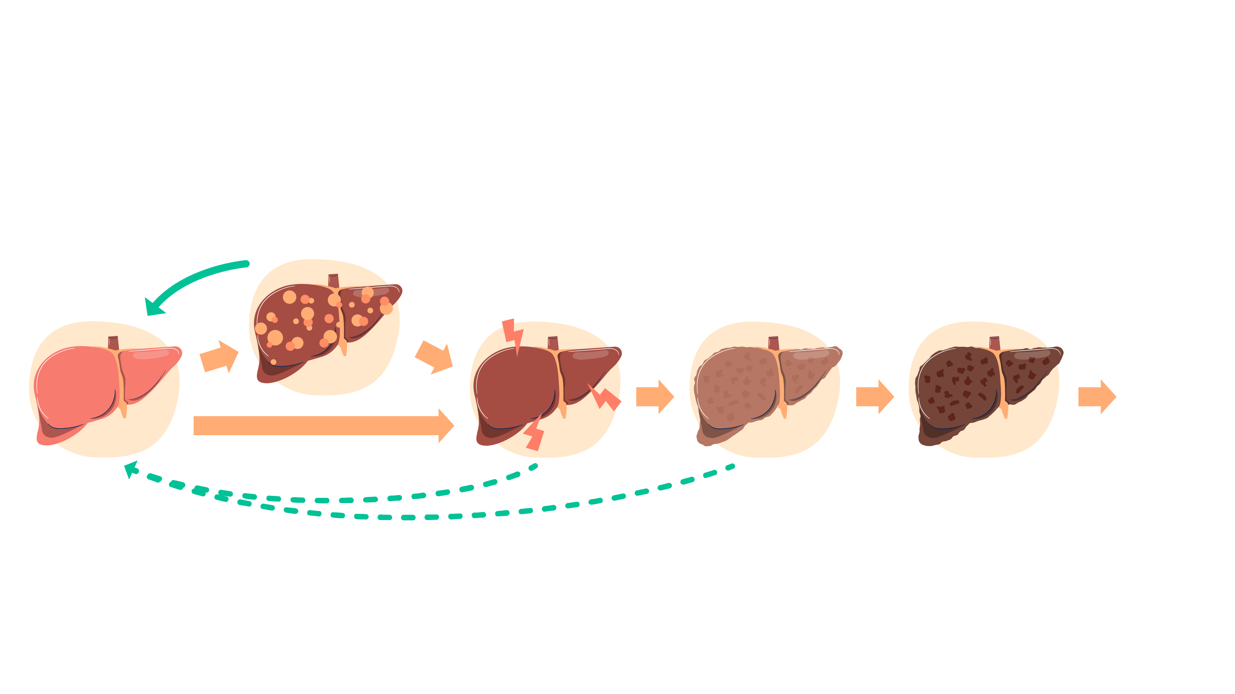
Stages of liver disease
Fatty liver
Healthy
liver
Hepatitis
(inflammation)
Fibrosis
(scarring)
Cirrhosis
Liver failure
Liver cancer

Slide 7

Who is at risk of
liver disease?
Liver disease can affect anyone but those
at risk of liver damage are people who:
Have a fatty liver
Drink too much alcohol
Have hepatitis B or hepatitis C
Have issues that affect their immune system
Are born with liver disease

Slide 8

What is viral hepatitis?
Hepatitis means inflammation of the liver.
In Australia the most common viruses that cause hepatitis
are the hepatitis A, hepatitis B and hepatitis C viruses.
 | How is it passed on? | Can it become chronic? (long term) | Is there a treatment? | Is there a cure? | Is there a vaccine?
Hepatitis A | Contaminated food and water | No | Not specific | Immune system | Yes
Hepatitis B | Mother to baby, blood to blood, sexual contact | Yes | Yes | No | Yes
Hepatitis C | Blood to blood contact | Yes | Yes | Yes | No

Slide 9

What are
the common
symptoms of
liver disease?
Symptoms include:
Feeling sick
Loss of appetite or weight loss
Yellowing of the eyes or skin (jaundice)
Swelling in the stomach and ankles
There are usually no symptoms until the liver is badly damaged

Slide 10

Testing for
liver disease
Talk to your doctor
or GP if you are worried or have questions about your liver health.
Blood tests –
check your liver function
Scans –
ultrasound, CT or MRI to see the liver and check for inflammation, swelling or scarring
Liver biopsy –
taking a small sample of your liver tissue to understand how your liver is functioning

Slide 11

Testing for hepatitis B
and hepatitis C
There are different types of blood tests for hepatitis B and C. They are easy and confidential.
Hepatitis B test results will tell you if you:
Hepatitis C test results will tell you if you:
Have chronic (long term) hepatitis B infection, and need care and treatment
Have developed protection against hepatitis B, and cannot get it again
Don’t have protection against hepatitis B, and need a hepatitis B vaccination
Have ever had hepatitis C but do not have it now
Have hepatitis C now and can get cured

Slide 12

Treating
liver disease
Treatment may be an option – your doctor will advise you if you need treatment.
With medications (provided by your GP), diet and exercise and managing a healthy lifestyle.
Once your liver is badly damaged (cirrhosis), it cannot be reversed.

Slide 13
Treating hepatitis B and hepatitis C
Hepatitis B
Hepatitis C
Chronic hepatitis B - see your doctor regularly (every 6-12 months) to check the health of your liver.
Treatment can reduce damage
to the liver and reduce the risk of liver cancer.
Your doctor will advise you if you need to take medication.
Hepatitis C is treated with medications called Direct Acting Anti-virals (DAAs). They are pills or tablets that:
Clear the virus from your body
Have few or no side-effects
Lower the risk of liver damage and getting liver cancer
Cure 95% of people living with hepatitis C.

Slide 14

How to protect yourself from hepatitis B and C?
Hepatitis B
GET VACCINATED
Hepatitis C:
Don’t share personal items like toothbrushes or razors
Only get tattoos or body piercings from licensed professionals
with sterile (clean) equipment
Only get medical and dental procedures by licensed professionals
Use condoms and lubricant during sex
Be careful about getting medical and dental procedures when travelling overseas
Wear gloves when cleaning up blood
Never share drug injecting equipment.

Slide 15

Caring
for your liver
There are four main lifestyle factors
that are important when caring for your liver
Eating well
Reduce or
stop alcohol
Exercise
Caring for yourself

Slide 16

Where to
get help
Find a GP
General Practitioner (GP)
www.healthdirect.gov.au/australian-health-services
Sexual health clinics - 1800 451 624
www.health.nsw.gov.au/sexualhealth
Multicultural HIV and Hepatitis Service
www.mhahs.org.au

Slide 17
Where to get help
in your language
If you need assistance with
talking to your doctor or health
provider in your language:
Call the Translating and Interpreting Service (TIS) on 13 14 50
The service is free and confidential
Ask the receptionist to book a free interpreter for you
17

Slide 18

What have we
learnt today?
True or False?
Your liver processes most things you eat and drink, even chemicals that touch your skin.
You know you have liver disease when you start feeling sick.
If left untreated, hepatitis B can cause liver disease.
The most important thing about liver health is doing lots of exercise.

Slide 19

Important messages
to take away
Eat a healthy diet and exercise regularly
Maintain a healthy body weight
Avoid or reduce alcohol intake
Monitor the health of your liver with your GP
Test for hepatitis B and C (hepatitis B vaccination is available)

Slide 20

Questions?

Slide 21

Developed by:
NSW Multicultural HIV
and Hepatitis Service
(MHAHS) mhahs.org.au
August 2025

