Slide 1
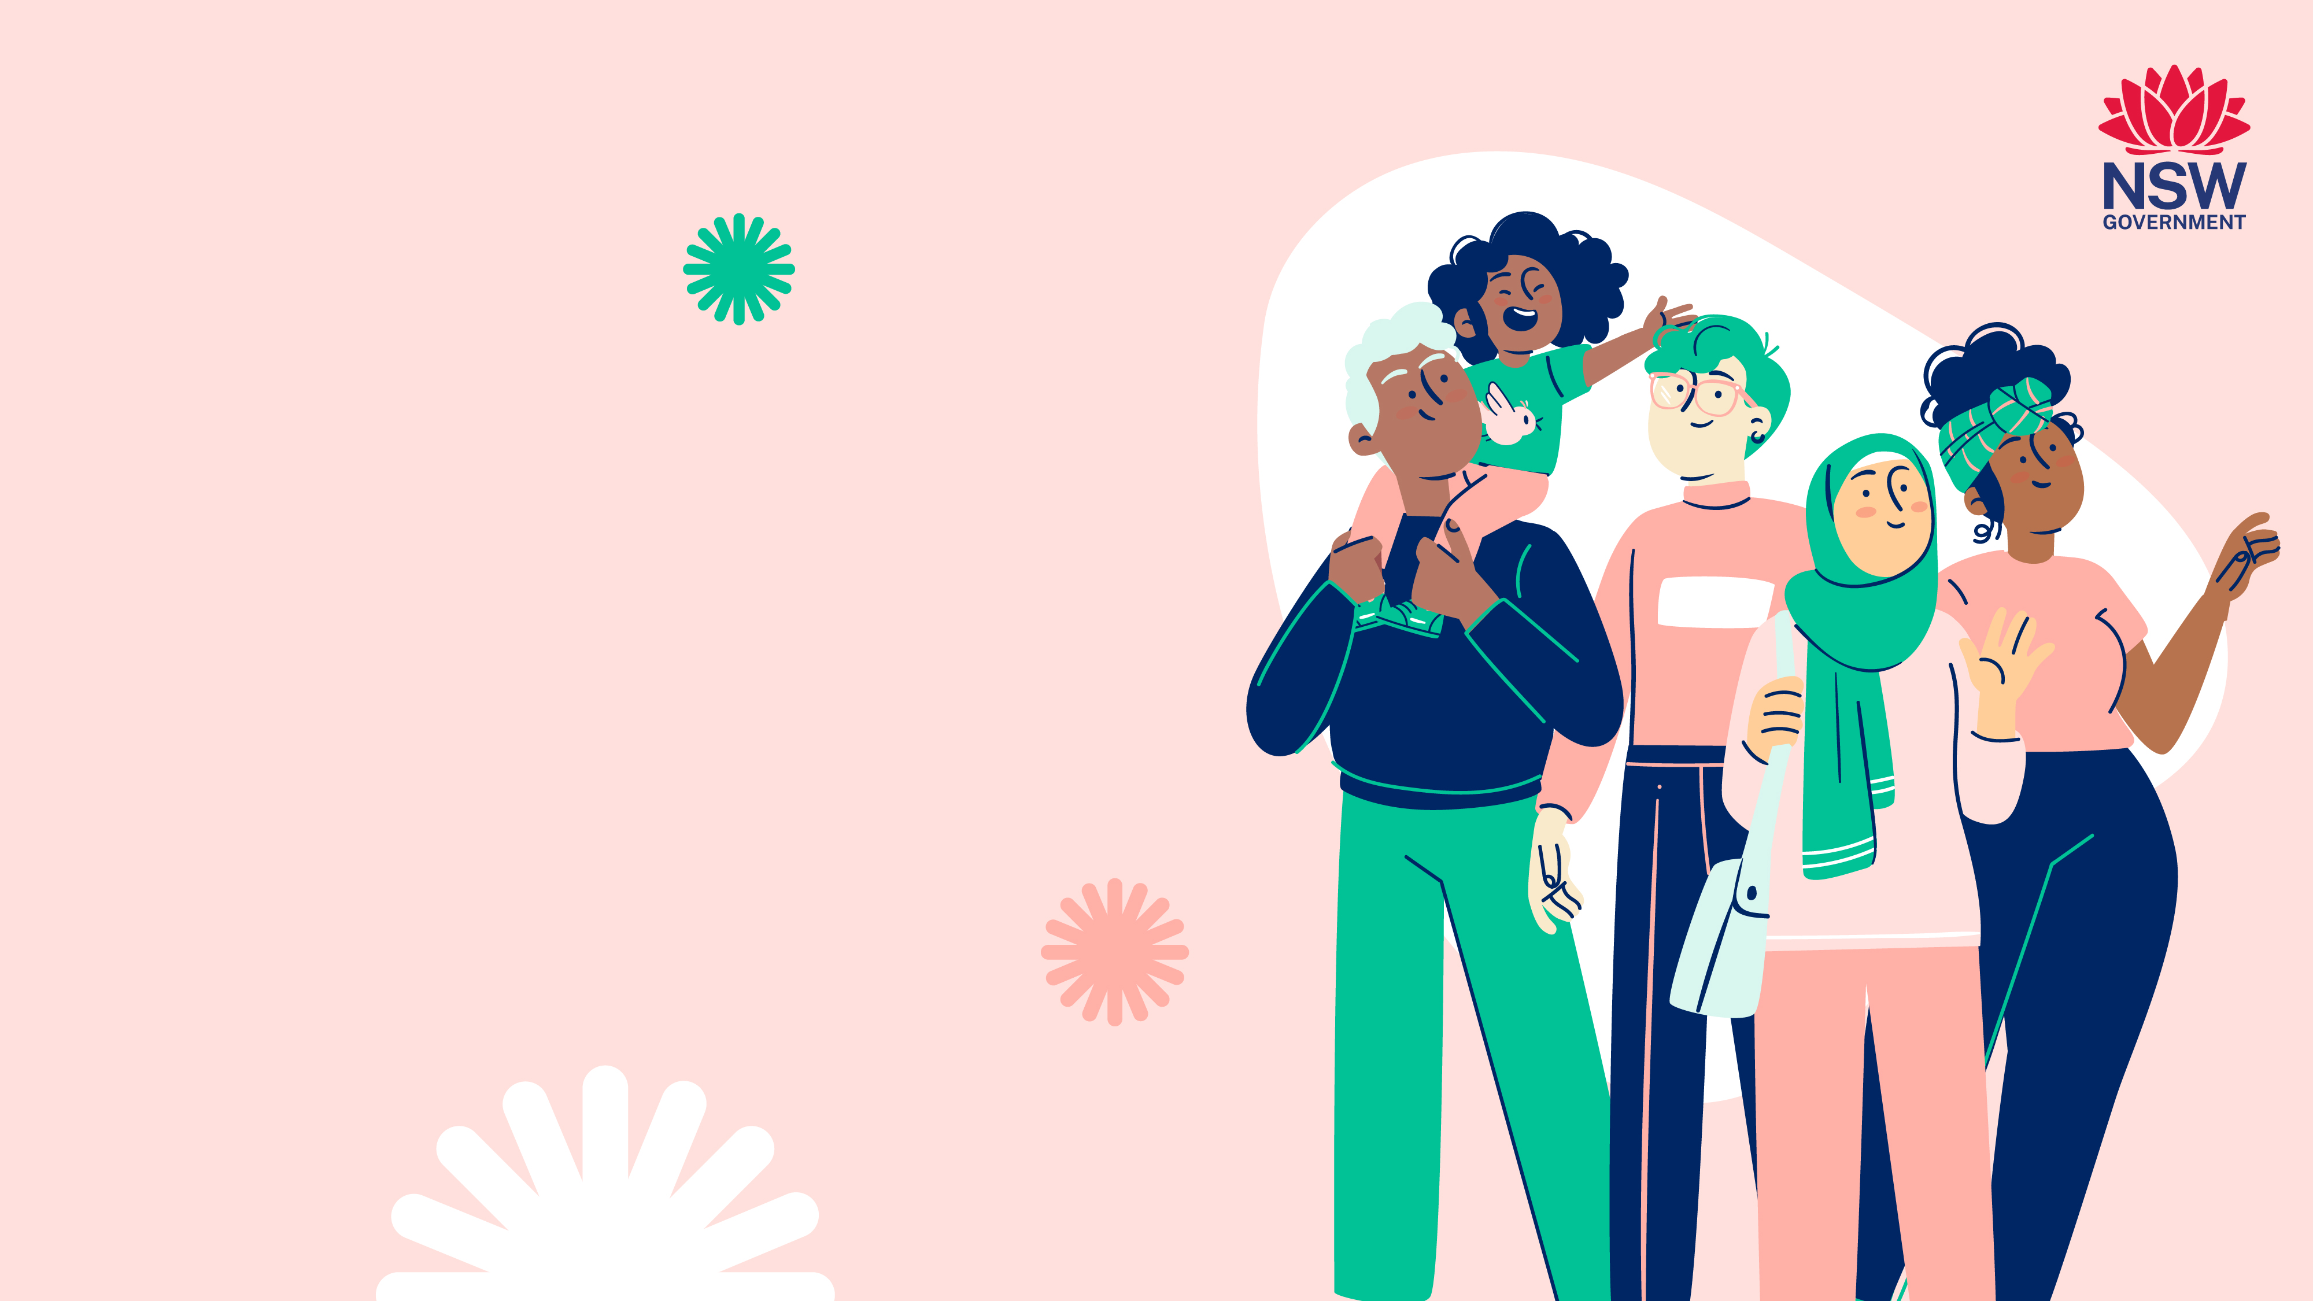
Understanding HIV
(Human Immunodeficiency Virus)

Slide 2

Today we will talk about…
HIV basics: What you need to know
Testing and treatment: Taking control of your health
Preventing HIV: Steps you can take to protect yourself
Understanding and breaking the stigma around HIV
Sharing your HIV status: What to consider
Finding help and support for HIV

Slide 3

What is HIV?
HIV attacks your immune system
The immune system protects
your body from diseases
HIV can lead to serious illness
if left untreated

Slide 4

Are HIV and AIDS
the same thing?
They are different.
AIDS stands for Acquired Immune Deficiency Syndrome.
AIDS is when the immune system is very damaged.
AIDS makes you very sick.
Without treatment HIV can cause AIDS

Slide 5
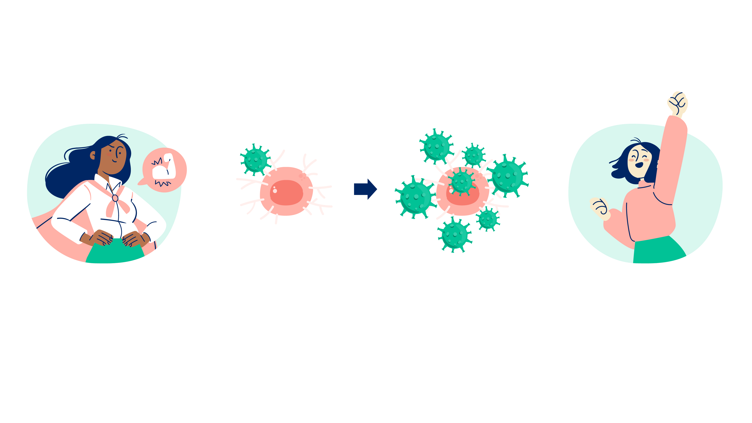
How does HIV
affect your body?
Your immune system protects you from infections and keeps you healthy
HIV attacks cells in your immune system (CD4 cells) which help fight germs
Without treatment, HIV weakens the immune system and can lead to AIDS
With treatment,
HIV is controlled
and the immune system stays strong

Slide 6
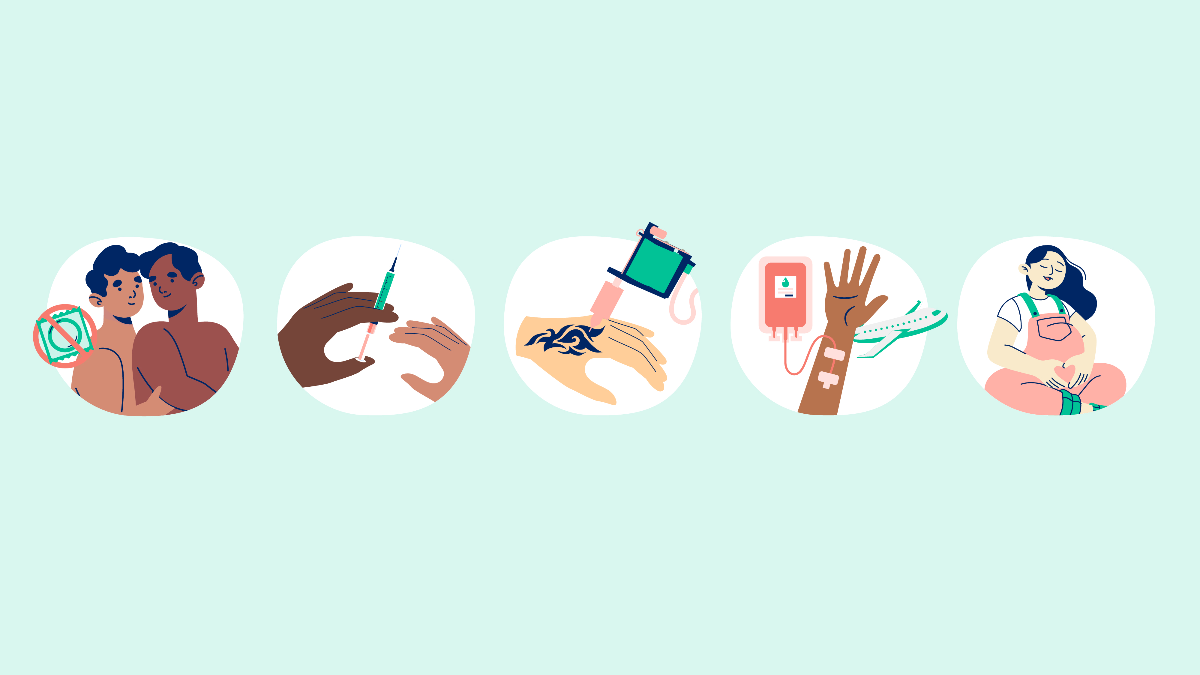
How do you get HIV?
HIV is found in bodily fluids such as blood, breast milk,
semen and vaginal fluids. It is passed on when bodily fluids
from a person with HIV enters the body of another person.
Having sex without a condom
Sharing needles and other equipment for injecting drugs
Body piercing
or tattooing
with unsterile equipment
Unsterile blood transfusions
and medical procedures done in some countries
From a HIV positive mother to her child during pregnancy, childbirth or breastfeeding

Slide 7
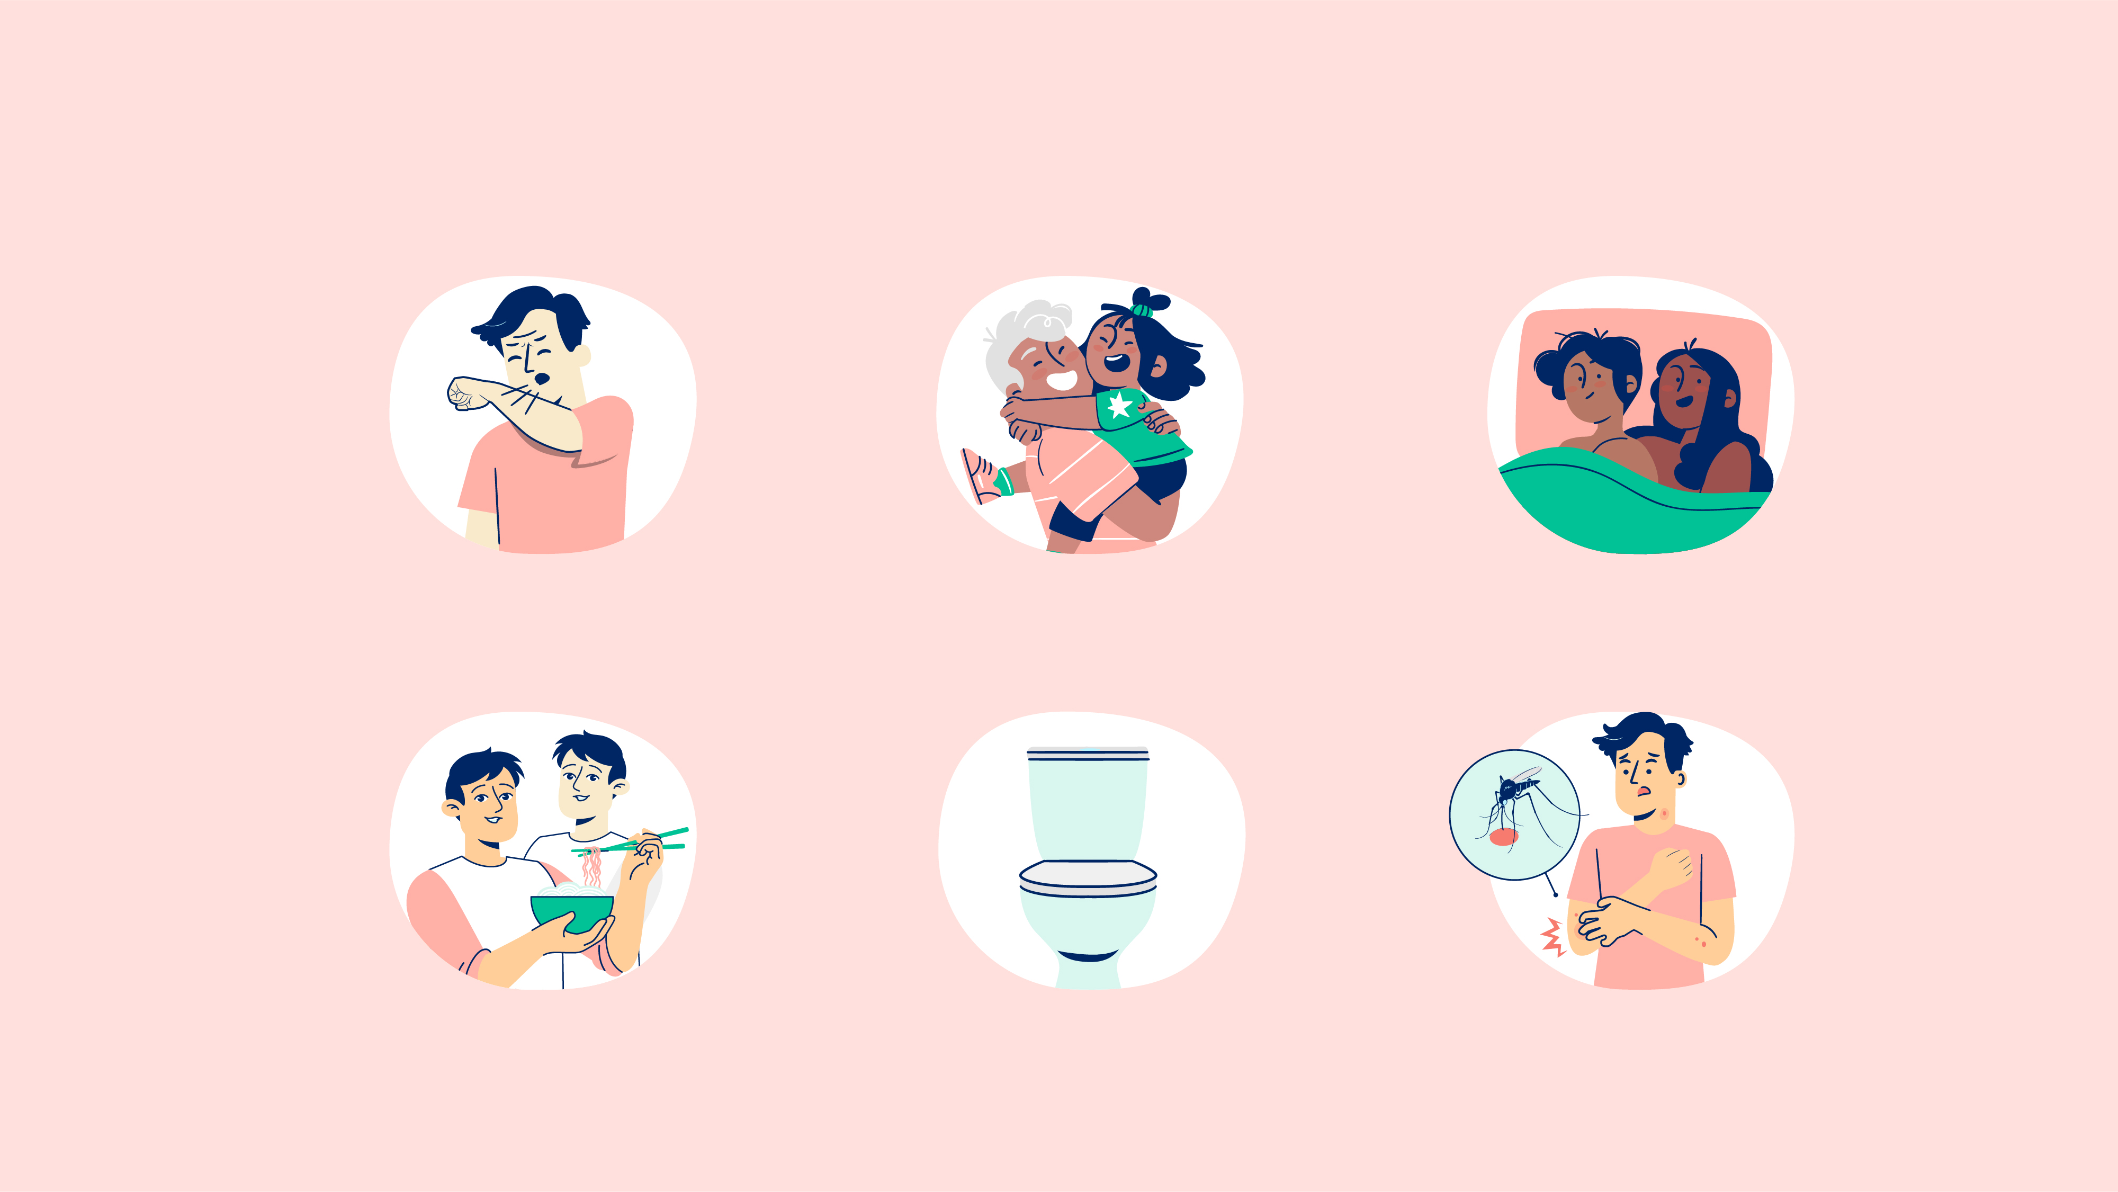
You cannot
get HIV from…
Coughing or sneezing
Kissing, hugging or crying
Sharing a bed with
someone who has HIV
Sharing food with
someone who has HIV
Sharing a toilet, a bath
or a shower with
someone who has HIV
Mosquito or
other insect bites

Slide 8

What are
the symptoms
of HIV?
Early symptoms may feel like the flu and include:
Feeling sick
Fatigue
Later symptoms may include:
Aches and pains
Fever
Sweating in bed at night
Skin rash
You may not have any symptoms when you first get HIV.

Slide 9

Testing for HIV
Blood test
Finger blood test
HIV blood (antibody) test
Small blood sample Sample is sent to a laboratory for testing Results in 1-3 days show if you have HIV
Your doctor Sexual Health Clinics Family Planning Centres
Rapid HIV test | Dried Blood Spot (DBS) test | MyTest HIV self-test
Drop of blood from your finger taken by a nurse Result is ready in 30 minutes | Drops of blood from your finger onto a sample card (self- collected) Sample is sent to a laboratory for testing Result is ready in a week | Drop of blood from your finger (self-collected) Result is ready in 15 minutes
At a[Test] clinic | Self test kit ordered online and sent to your address | Register online and collect test kit from a vending machine

Slide 10

Who should get tested?
You should get tested if you:
Are a man who has sex with other men
Have had more than one sexual partner and
you didn’t always use a condom
Have a partner who is living with HIV
Have a partner who is living with HIV and want
to have a baby
Have ever shared needles or other equipment
to inject drugs or steroids
Have had injections, tattoos, piercings, dental
or medical procedures overseas.

Slide 11

What is the treatment
for HIV?
HIV is treated with medication
called antiretrovirals (ARTs).
HIV treatments are very effective and lifelong.
The earlier you start taking HIV treatments
the better it is for your health.

Slide 12
How does HIV
treatment work?
undetectable viral load
HIV treatments:
Stop the virus from damaging your
immune system by reducing the amount
of virus in your blood (viral load)
Viral load describes how much HIV
you have in your blood
You need to take the treatment regularly
to reduce your viral load.
detectable
level
undetectable
level
An undetectable viral load
means that you cannot pass on HIV.
viral load
before ART
viral load
with ART

Slide 13

How can I protect myself from getting HIV?
Condoms and water-based lubricant
protect you and others from HIV.
PrEP (Pre-exposure prophylaxis) - HIV treatment
to protect yourself from getting HIV.
PEP (Post-exposure prophylaxis) - HIV treatment
you take after you may have come into contact with
HIV to help protect you from getting it.
Use clean equipment to inject drugs (don’t share needles).
Test regularly for HIV.

Slide 14

Understanding
stigma around HIV
Stigma affects those living with HIV,
especially in relationships, sex, and sexuality.
Many people living with HIV are affected
by stigma because of:
Assumptions about how they got HIV
Behaviours associated with HIV.
These assumptions can
influence a persons’ willingness
to disclose their HIV.
Stigma creates barriers to
healthcare and support.

Slide 15

Who to tell
and not tell
Ask your doctor about steps to protect you and your partners.
In NSW, by law, you don’t need to tell someone that you have HIV before having sex as long as you take ‘reasonable precautions’
Reasonable precautions include:
Using a condom
Having an undetectable viral load
(from being on HIV treatment)
Making sure your sexual partner
is taking PrEP.

Slide 16

Where to
get help
Multicultural HIV and Hepatitis Service
www.mhahs.org.au | (02) 9515 1234 | Forest Lodge
ACON
www.acon.org.au | 1800 063 060 | Surry Hills
(02) 4962 7700 | Newcastle | (02) 6622 1555 | Lismore
Positive Life NSW
www.positivelife.org.au | 1800 245 677 | Surry Hills
Pozhet (Heterosexual HIV Service NSW) www.pozhet.org.au | Forest Lodge
Sexual Health InfoLink
www.shil.nsw.gov.au | 1800 451 624
Bobby Goldsmith Foundation (BGF)
www.bgf.org.au | (02) 9283 8666 | Darlinghurst and Parramatta
HIV/AIDS Legal Centre (HALC)
www.halc.org.au | (02) 9492 6540 | Surry Hills
Sex Workers Outreach Project | www.swop.org.au | (02) 9184 9466

Slide 17
Where to get help
in your language
If you need assistance with
talking to your doctor or health
provider in your language:
Call the Translating and Interpreting Service (TIS) on 13 14 50
The service is free and confidential
Ask the receptionist to book a free interpreter for you.
17

Slide 18

What have we
learnt today?
True or False?
You can get HIV from sharing a toilet
with someone who has HIV.
HIV can be transmitted through mosquito bites.
A person with HIV who has an undetectable viral load
cannot pass on the virus.
You can get HIV from kissing someone who is HIV positive.
People with HIV who are on treatment
can live long, healthy lives.
HIV can be prevented by using condoms or taking PrEP.

Slide 19

Important messages
to take away
The only way to know if you have HIV is by
getting tested.
Regular testing for HIV is important.
HIV can be effectively managed with treatment.
Starting treatment early is very important
for your health.
Follow your treatment exactly as prescribed.
If you need support or face discrimination,
seek legal advice and support services.

Slide 20

Questions?

Slide 21
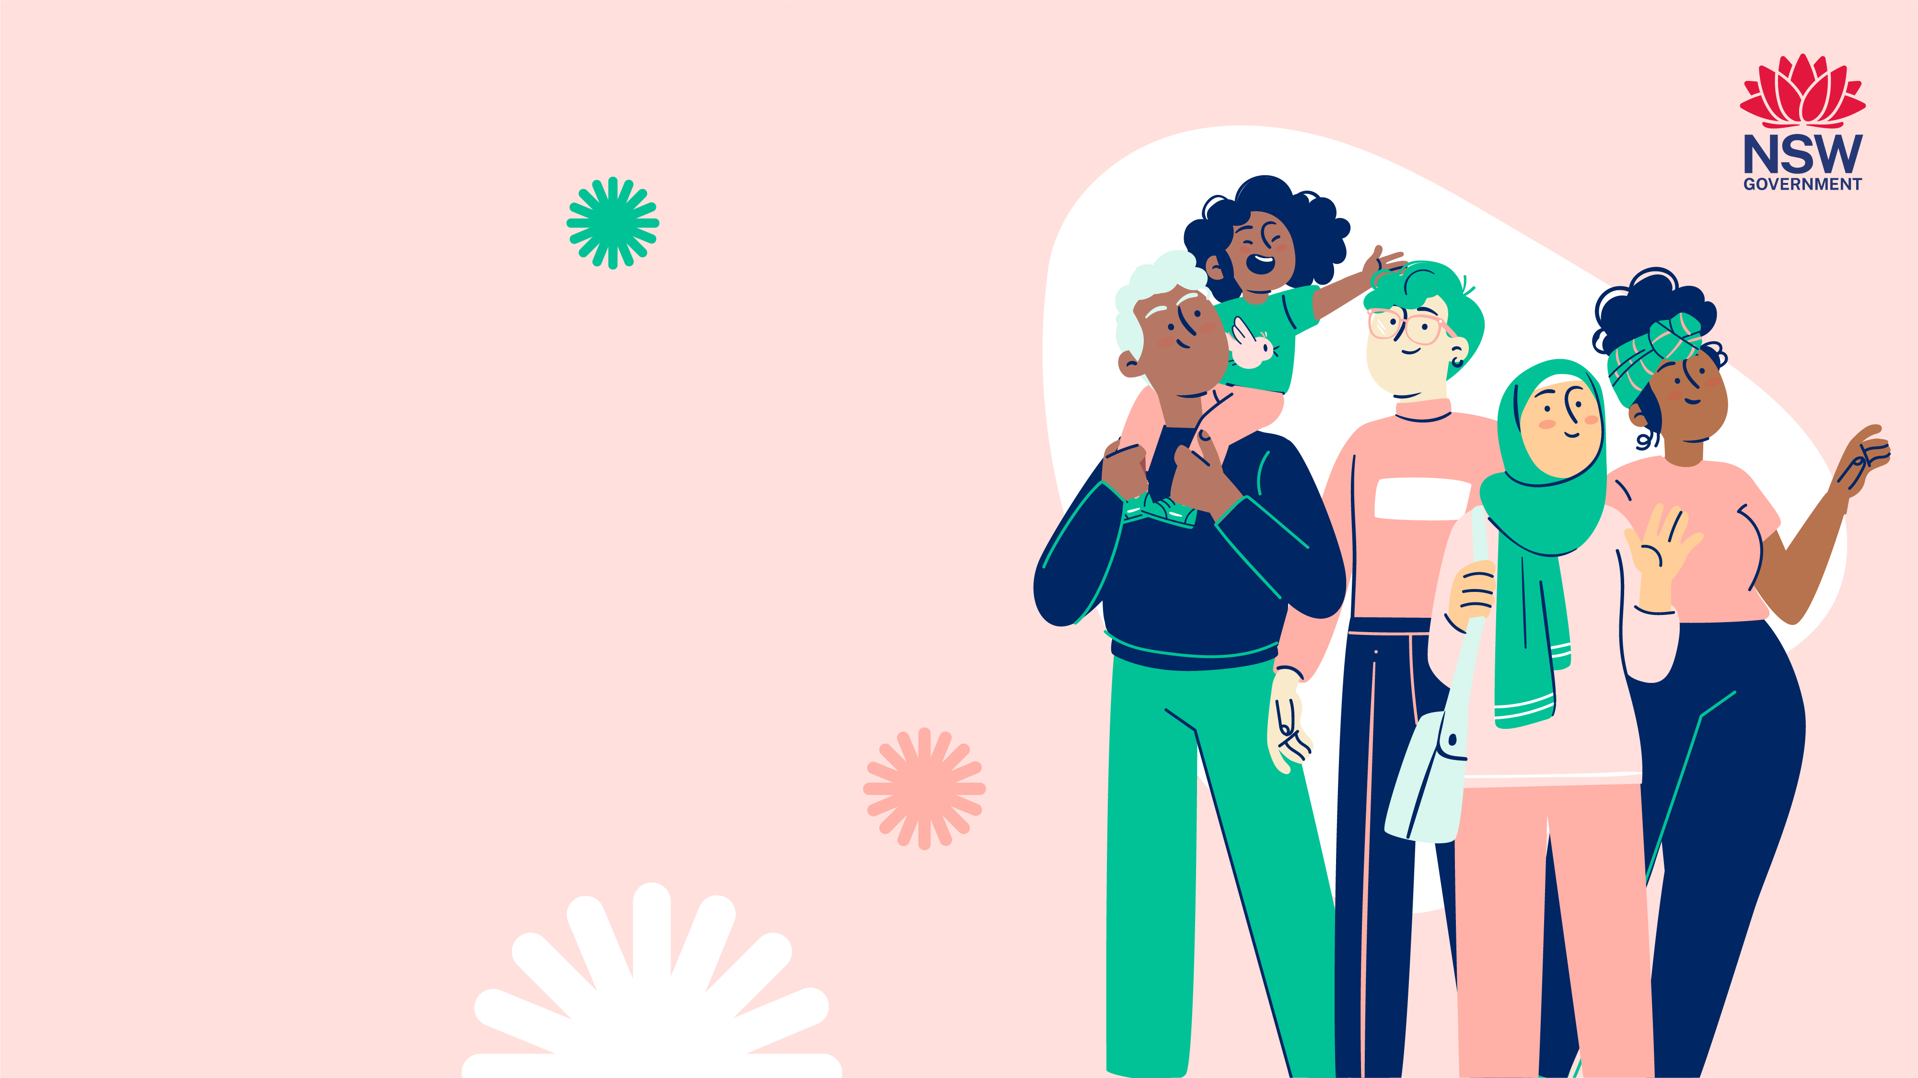
Developed by:
NSW Multicultural HIV
and Hepatitis Service
(MHAHS) mhahs.org.au
August 2025

